Slide 1
CSE322
NDFA WITH NULL MOVES AND REGULAR EXPRESSION
Lecture #7

Slide 2
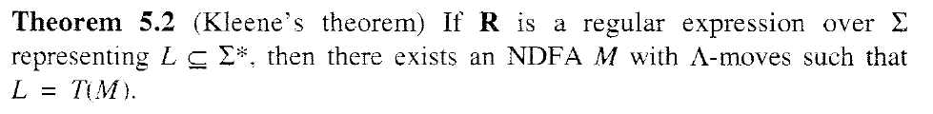
NDFA WITH NULL MOVES & RE

Slide 3
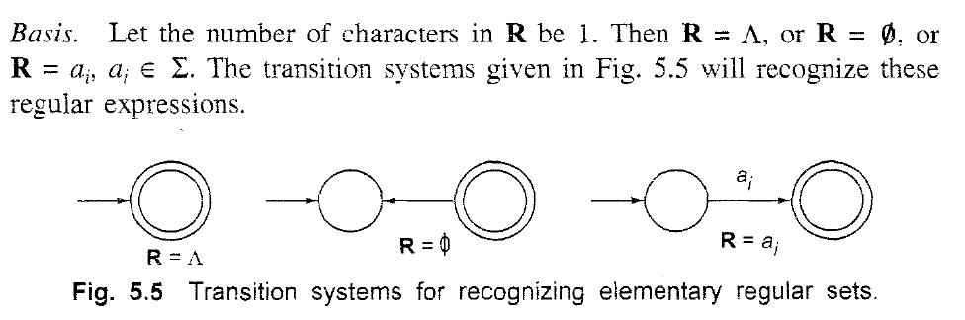
NDFA WITH NULL MOVES & RE

Slide 4
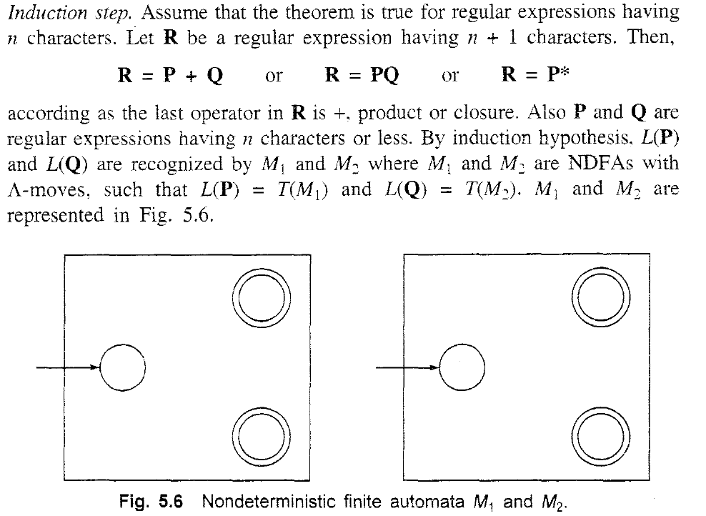
NDFA WITH NULL MOVES &RE

Slide 5
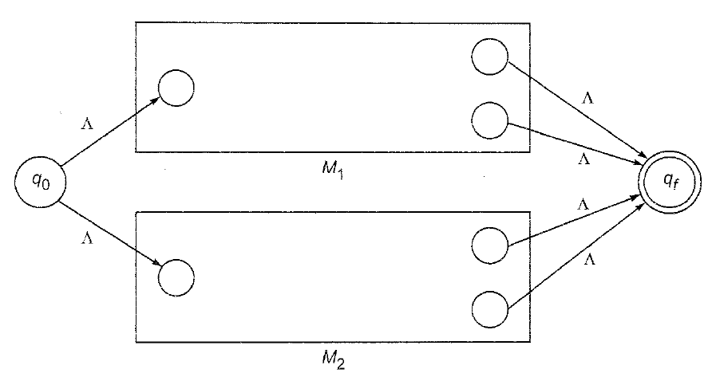
CASE1 :R=P+Q

Slide 6
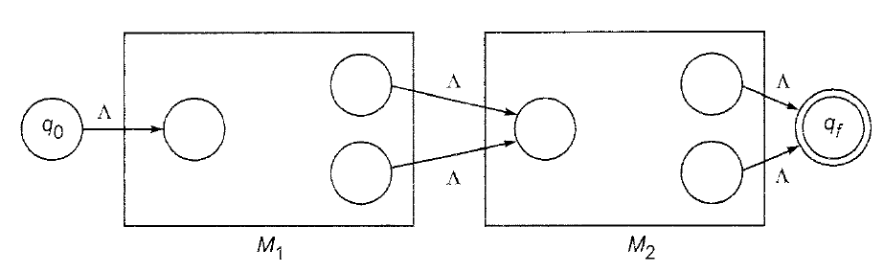
CASE2:R=PQ

Slide 7
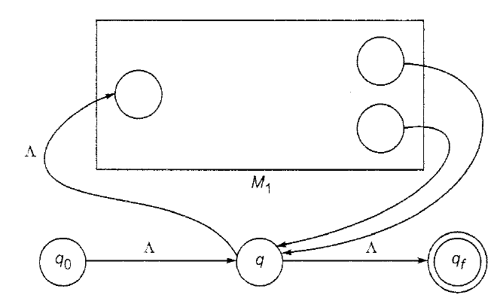
CASE 3:R=(P)*

Slide 8
CONVERSION OF NDS TO DS
Step 1: Convert the given transition system into state transition table where each state corresponds to a row and each input symbol corresponds to a column.
Step 2:Construct the successor table which lists the subsets of states reachable from the set of initial states. Denote this collection of subsets by Q’.
Step 3: The transition graph given by the successor table is the required deterministic system. The final states contain some final state of NDFA. If possible, reduce the number of states

Slide 9
IMPORTANT NOTE
In the earlier method for automata, we started with [q0]. Here we start with the set of all initial states. The other steps are similar.

Slide 10
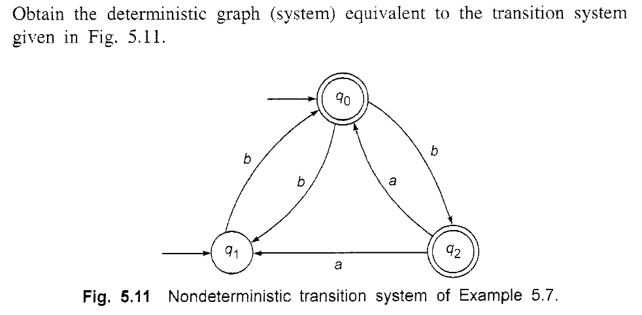
PROBLEM

Slide 11
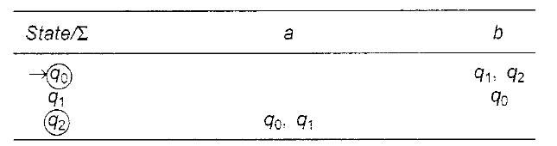
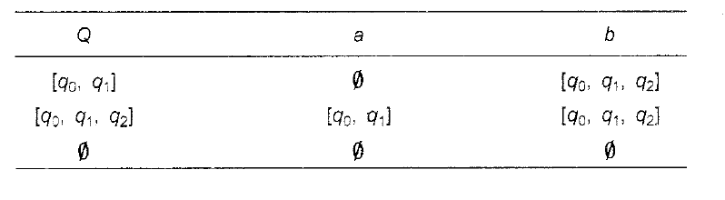
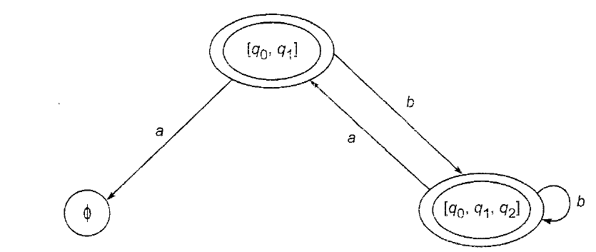
SOLUTION

